Slide 1
AirBnB vs Housing
In San Francisco
Chris Burk
Emma Holtgrieve
Simon Murray

Slide 2
Introduction
Is the proliferation of the short-term rental market bad for long-term rental ecosystem for permanent residents?

Slide 3
Questions to Focus On
How does the price of a short term rental like AirBnB compare to the average rent of a comparable property in the area?
Is the rate of vacancy for AirBnB’s higher than the rate of vacancy for normal rental units? Why is this important?
How does the average income from AirBnB rental for hosts compare to average household income in the area?

Slide 4
Sourcing Data
insideairbnb.com/san-francisco - This was the source of our scraped AirBNB listing data.
census.gov - This was the source of our housing data for the San Francisco City/County area.

Slide 5
Question 1
How does the price of a short term rental like AirBnB compare to the average rent of a comparable property in the area?

Slide 6
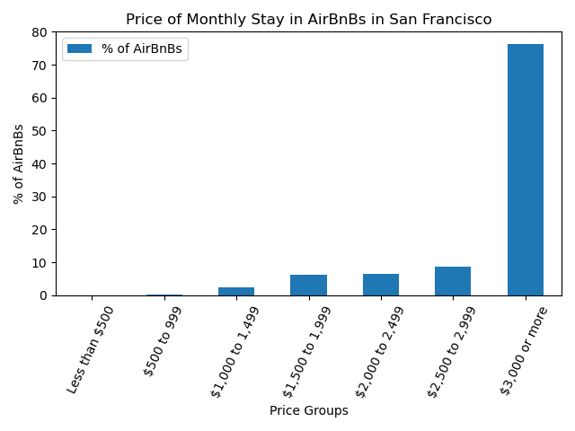
What is the average price of a monthly stay in an AirBnB?
Out of 7,418 listings total
Prices per night ranged anywhere from $80 to $1,000
76% of AirBnBs reported to have a monthly price of $3,000 or more

Slide 7
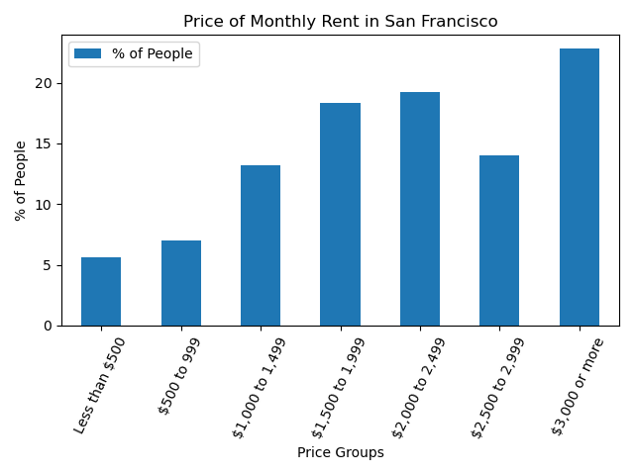
What is the average reported rent in the same area?
Survey done by the Census called the American Community Survey
Covered a total of 748,165 people living in the city
Similar percentages found between people paying $1,500 to $2,499
18.3% to 19.2% respectively
Largest percentage of people reported to be paying $3,000 or more (22.8%)

Slide 8
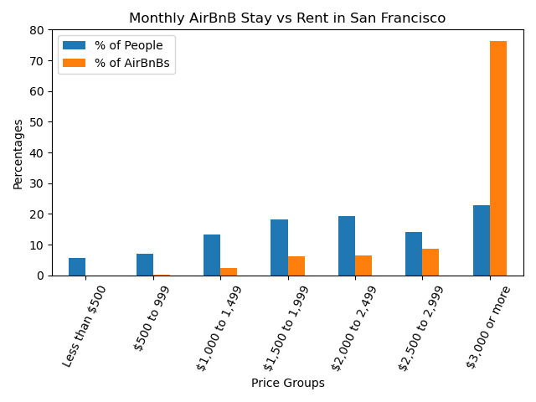
Answer?
Comparatively, the results are pretty similar
There isn’t any cheaper option when deciding between an AirBnB or normal rental
AirBnB pricing might not have an effect on rental prices
OR
Lack of new available housing could be causing high and competitive prices

Slide 9
Question 2
Is the rate of vacancy for AirBnB’s higher than the rate of vacancy for normal rental units? Why is this important?

Slide 10
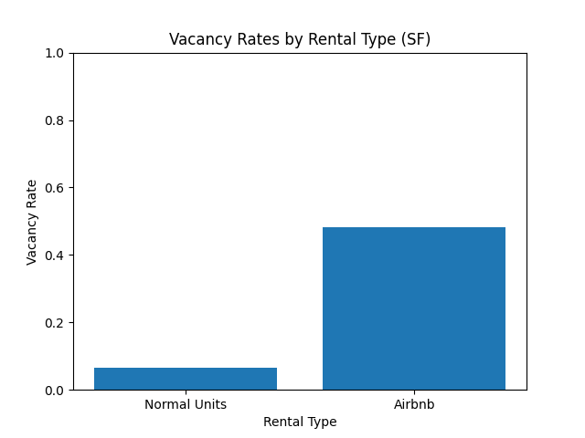
Comparing vacancy rates by rental type
Normal Units - 6.6%
Airbnb - 48.12%
With the low number of vacancies, pricing may be affected for normal units

Slide 11
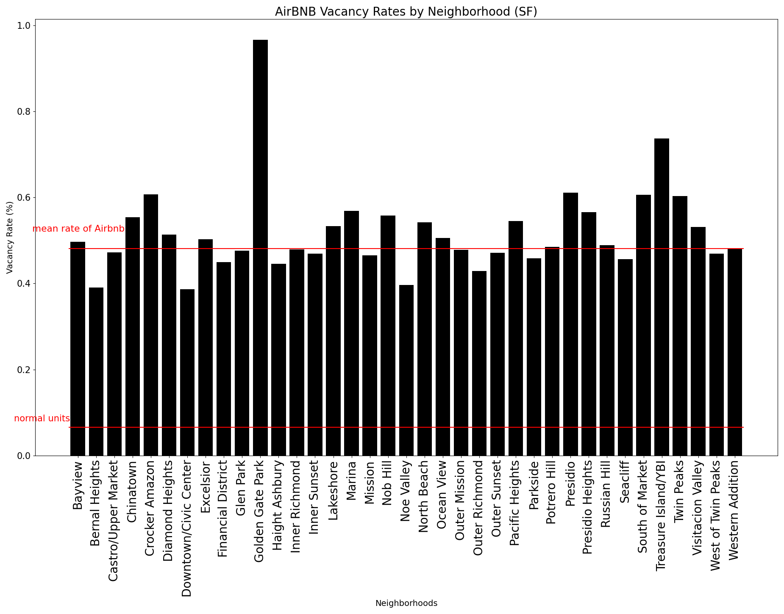
Comparing vacancy rates by neighborhood
Most neighborhoods between 40 - 60%
Least vacant neighborhood is still a lot more vacant than the normal units rate
Most Airbnbs are vacant around half the year - can have a big effect on the housing market

Slide 12
Question 3
How does the average income from AirBnB rental for hosts compare to average household income in the area?

Slide 13
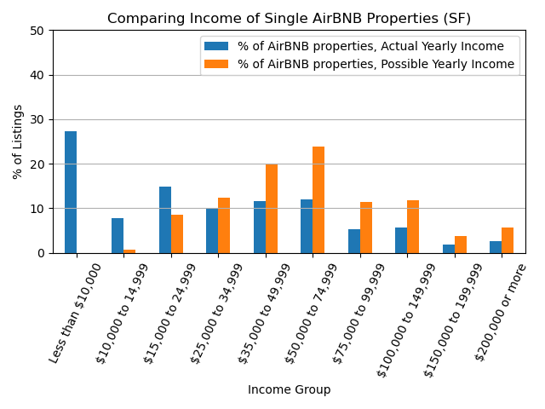
Comparing income of AirBNB properties
Out of 7,418 listings total
Average AirBNB property income: $66,777
Almost 30% of properties made less than $10,000 - a fair majority of these listings made no money at all

Slide 14
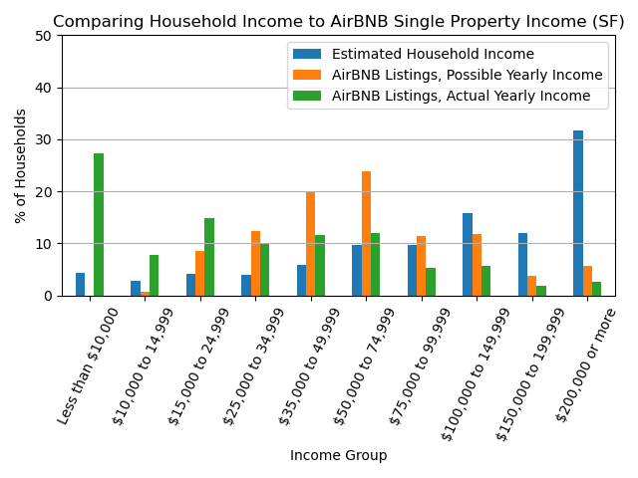
Comparing AirBNB properties to SF household income
Out of 7,418 listings total
Census data from 1,739,127 households in San Francisco
Average AirBNB property income: $66,777
Average household income in San Francisco: $184,370
Median household income in San Francisco: $128,151

Slide 15
Conclusion - Supply and Demand
BNB pricing may not have a direct influence on the pricing of traditional apartments, or it may highlight a potential housing shortage within the city, which could be driving up prices.
Vacancy rates of BNBs could potentially have implications for pricing, as it suggests a disparity in supply and demand within the area.
BNBs have a relatively high average income despite high vacancy rates. This is significant because if AirBNB properties were on the market as conventional rentals, they would likely have a much lower vacancy rate and, consequently, a higher actual yearly income per property.

